Slide 1
CS 2009 Design and Analysis of Algorithms
Zohaib Ali
Email : zohaibali.cs@tuf.edu.pk

Slide 2
Lecture 1: Introduction & Course Overview

Slide 3

Self Introduction
Zohaib Ali
Lecturer in DCS, TUF
Education
MSCS form the FAST-NUCES
Experience
Research Associate at Fast-NUCES
Web Developer

Slide 4

Evaluation Plan
Evaluation Type | Points
Quiz | 10
Assignment | 15
MID | 25
Presentation | 10
Final | 40

Slide 5
Class Guidelines
Raise your hand before asking any question and then WAIT for the permission.
Please don’t miss a class.
Please don’t use mobile phones in the class.
Plagiarism in research work is not allowed.
No Makeup Quiz OR Assignments will be given.
Final exam will be selective comprehensive.

Slide 6
Text & Reference Books
Required Textbook
Thomas H. Cormen “Introduction to Algorithms” 3rd Edition
Reference Books
Anany Levitin “Introduction to the Design and Analysis of Algorithms” 3rd edition
Jon Kleinberg and Éva Tardos “Algorithm Design”
Sanjoy Dasgupta et al. “Algorithms”
Steven S. Skiena “The Algorithm Design Manual”

Slide 7
Course Objectives
This course introduces students to the analysis and design of computer algorithms. Upon completion of this course, students will be able to do the following:
Analyze the asymptotic performance of algorithms.
Accuracy
Efficiency
Comparing Efficiencies
Demonstrate a familiarity with major algorithms and data structures.
Apply important algorithmic design paradigms and methods of
analysis.
Synthesize efficient algorithms in common engineering design situations.
Gain familiarity with a number of classical problems that occur frequently in real-world applications
5

Slide 8
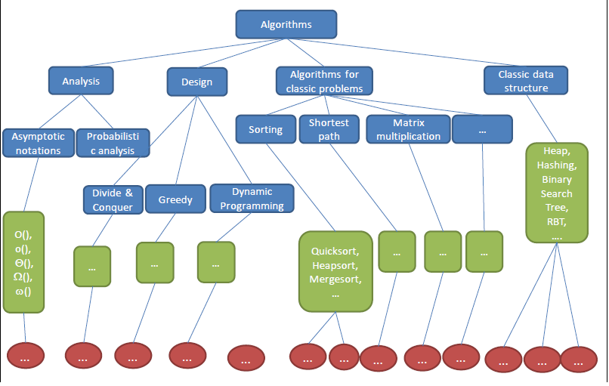
Knowledge tree

Slide 9
What is an algorithm?

Slide 10
What is Algorithm
Informally, an algorithm is any well-defined computational procedure that takes some value as input and produces some value as output. (Thomas H. CORMEN)
"An algorithm is a well-defined sequence of instructions to solve a specific problem or perform a task.”
E.g.
Multiply Two Numbers.
Algorithms to Sort Array.

Slide 11
Algorithm Specification
We can specify an algorithm by 3 types:
Using Natural language
Step1: read the first number (assume a)
Step2:read the second number (assume b)
Step3:add 2 numbers(a and b)and store the result in a variable c
Step4:display the result
Pseudocode
//this algo perform addition of two integers
//input two integers a and b
// output of two integers C=a+b
Write c

Slide 12
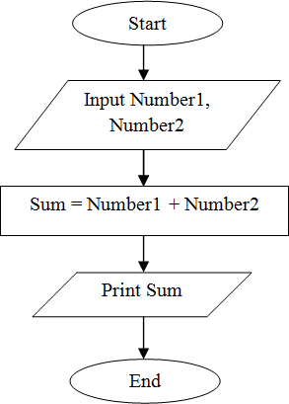
Algorithm Specification
We can specify an algorithm by 3 types:
Flow chart

Slide 13
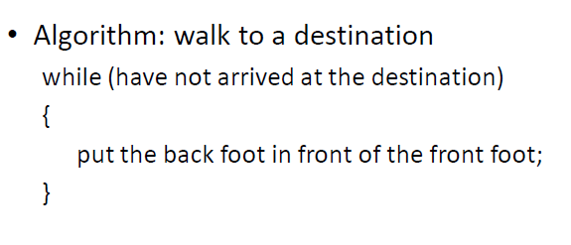
Examples of Algorithms - Walk

Slide 14
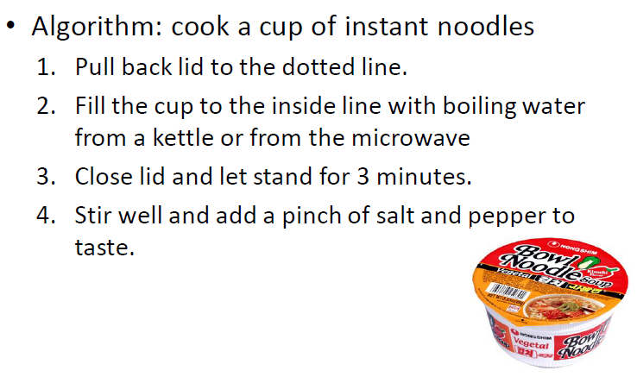
Examples of Algorithms – Cook Noodles

Slide 15
MULTIPLICATION: THE PROBLEM
Input: 2 numbers, x and y (n digits each)
Output: the product x · y
4456
x 1123
5004088

Slide 16
Why Study Algorithms ?

Slide 17
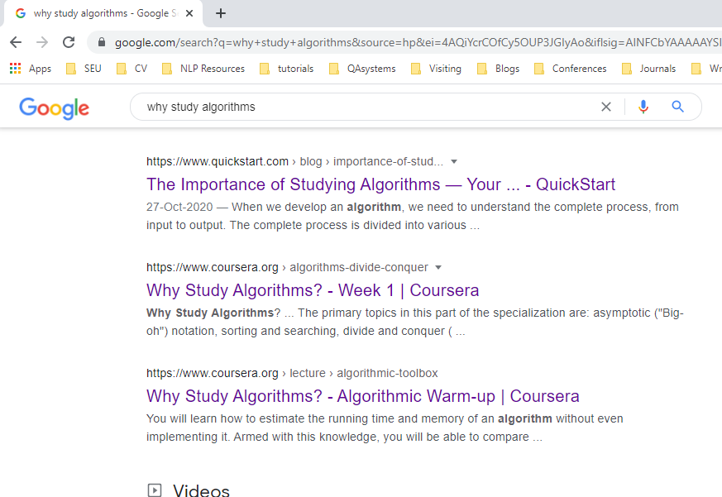
Web Search

Slide 18


Personalized Recommendation
More than 70% of what people watch on YouTube is determined by its recommendation algorithm.
News Feed, Friend Suggestions

Slide 19

Human Genome Project

Slide 20

Security E-commerce

Slide 21
Lot of Applications
Internet. Web search, Packet routing, distributed file sharing,...
Biology. Human genome project, protein folding, …
Data Mining. Text Classification, Text Clustering, Page Rank
Security. E-commerce, Cell phones, Voting machine
Web programing. Sorting Algorithms, Searching algorithms
Graphics. Video Games, Virtual Reality,
Social networks. Recommendations, news feed
Machine Learning AI. Linear Regression Algorithm, Deep Neural Networks such RNN, CNN
Robotics. Planning Algorithms.

Slide 22
Why Study Algorithms?
To become proficient programmer.
To solve problems that could not be solved.
For fun and profit.

Slide 23
What we are interested in Algorithms
Correctness
Does it work correctly?
Performance/Efficiency
How much time will it take? (Time Complexity)
How much space will it take? (Space Complexity)
Can We do it better?

Slide 24
What’s more important than performance?
_{Correctness}
_{Robustness}
_{User-friendliness}
_{Simplicity}
_{Extensibility}
_{Reliability}

Slide 25
Correct Algorithm
An algorithm is said to be correct if, for every input instance, it halts with the correct output.
Correct Output
Input
Algorithm
Incorrect Output
Loop Infinitely

Slide 26
How to measure an algorithm?
The number of key operations
The number of space units needed
E.g. Search a book in a box of books
Key operation: check the title of a book
Space unit: the space for one book

Slide 27
Which Running Time Is Better? (Less is better)
Is 1000000n operations better than 4n²?
Is 0.000001n³ operations better than 4n²?
Is 3n² operations better than 4n²?

Slide 28
Which Running Time Is Better? (Less is better)
Is 1000000n operations better than 4n²?
Is 0.000001n³ operations better than 4n²?
Is 3n² operations better than 4n²?
The answers for the first two depend on what value n is…
1000000n < 4n² only when n exceeds a certain value (in this case, 250000)
These constant multipliers are too environment-dependent...
An operation could be faster/slower depending on the machine, so 3n² ops on a slow machine might not be “better” than 4n² ops on a faster machine

Slide 29
Which Running Time Is Better?
Computer A (Faster): Run algorithm of 2n² complexity. Run 10 billions instruction per second.
Computer B (Slower): Run Algorithm 50 n log n complexity. Run 10 millions instruction per second.
Input length n = 10 millions
2 . (10⁷)²Instructions
10¹⁰ Instructions/second
= 20,000 seconds (> 5.5 hours)
50 . 10⁷ log 10⁷Instructions
10⁷ Instructions/second
= 1163 seconds (< 20 minutes)
Notes:
23.25

